Slide 1


Welsh Government
Learning in Digital
Wales update
Software Development Forum
10 February 2015
Notes:
1

Slide 2

Learning in Digital Wales work streams
Hwb (the National Digital Content Repository)
Hwb Networks
Hwb+ (the all-Wales learning platform)
Hwb+ Centres of Excellence Programme
Hwb+ public-facing websites
Office 365
e-Safety including web filtering standards
Additional consortia funding to support the implementation of Hwb+
Computing workshops for secondary schools
HwbMeet events
National Digital Learning Event
Learning in Digital Wales Evaluation
Jisc
ICT Infrastructure - Learning in Digital Wales Grant and Janet
www.cymru.gov.uk

Slide 3

Hwb Statistics
15,379 accounts active (total)
November 2014
Total page views - 810,597
Searches – 55,900
December 2014
Total page views – 401,084
Searches – 29,000

Slide 4
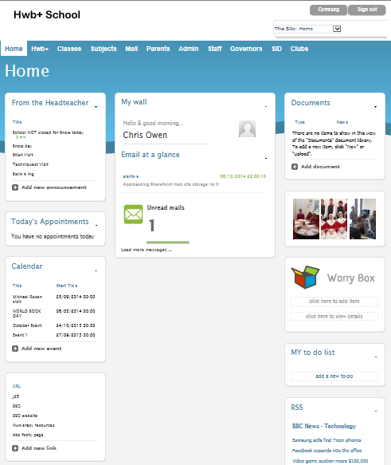
Hwb+ Statistics
540,000 accounts active
December 2014
Total page views – 328,683
Logins – 107,435
More than 10 logins – 562 schools

Slide 5

Digital Leader Hwb+ Training
Modules
Getting started with Hwb+
Supporting literacy within the LNF 1 & 2
Supporting numeracy within the LNF
Office 365
A strategic approach to Hwb+ for school leaders
Customising Hwb+
Hwb+ and the paperless classroom
Staff communication
Hwb+ support

Slide 6
Hwb National Digital Content Repository update
  Released refreshed Hwb site including National Digital Content Repository and Single Sign On
  Refreshed Hwb site includes improved search and discoverability
  Schools across Wales now have access to premium tools such as Encyclopaedia Brittanica

Slide 7
Hwb+ top 20 schools
Alderman Davies CIW Primary | Neath and Port Talbot | ERW
Cadoxton Primary | Vale of Glamorgan | CSC
Penygloddfa C.P. School | Powys | ERW
Ysgol Brynhyfryd | Denbighshire | North
Ysgol Cynwyd Sant | Bridgend | CSC
Dwr Y Felin Comprehensive School | Neath and Port Talbot | ERW
Cefn Saeson Comprehensive School | Neath and Port Talbot | ERW
All Saints Primary | Vale of Glamorgan | CSC
Gwenfro Community Primary School | Wrexham | North
St Francis Catholic Primary School | Pembrokeshire | ERW
Presteigne CP School | Powys | ERW
Rhydypenau Primary school | Cardiff | CSC
High Street Primary | Vale of Glamorgan | CSC
Barry Comprehensive School | Vale of Glamorgan | CSC
Undy Primary | Monmouthshire | EAS
Queen Elizabeth High School | Carmarthenshire | ERW
Llansantffraid C.I.W.A. School | Powys | ERW
Radnor Primary School | Cardiff | CSC
Machen Primary | Caerphilly | EAS
Llanidloes High School | Powys | ERW

Slide 8
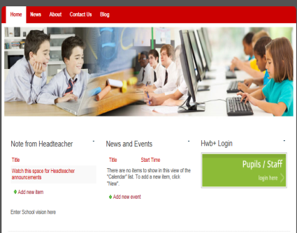
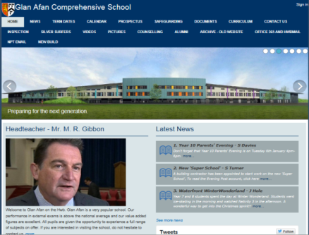
Hwb+ public-facing websites
Two websites: one English and one Welsh per school
Basic functionality which can be customised
Out of the box
Customised

Slide 9
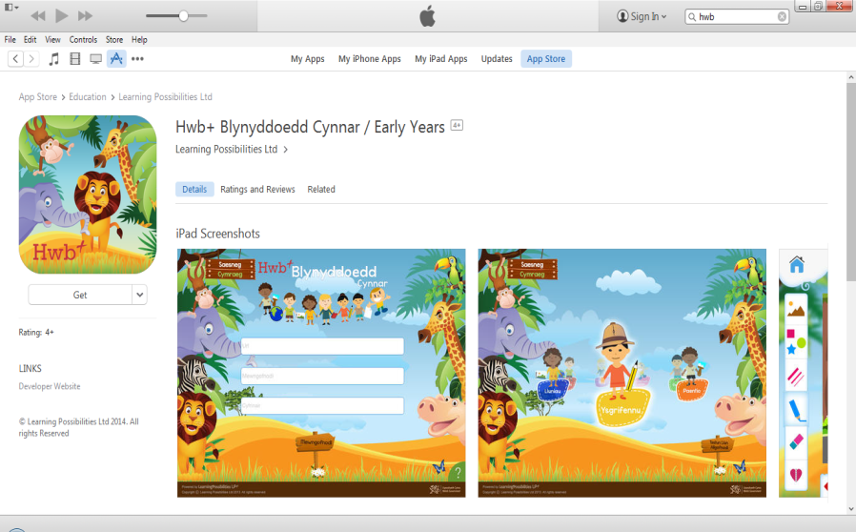
Hwb+ Early Years iOS App

Slide 10

Notes:
10

Slide 11
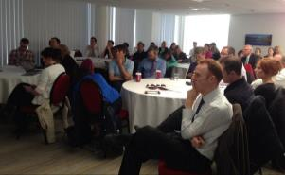

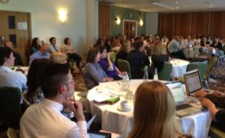
HwbMeet Timetable 2014/2015
Aberystwyth – Over 45 teachers attended
21/10/14
Isle of Anglesey – Over 60 teachers attended
18/11/14
Swansea
20/01/15
Newtown
03/02/15
Cowbridge
10/03/15
Mold
12/05/15
Pembrokeshire
16/06/15
Pwllheli
07/07/15

Slide 12

Computing workshops for secondary schools update
Local workshops delivered for Python, LEGO, Scratch, Raspberry Pi and Java
Schools engaged – 20
Teacher attendees – 31
Learner attendees – 452
4 x 6 week Python programming CPD modules delivered to 32 teachers

Slide 13
Key LiDW successes
Hwb and Hwb+ launch and provisioning (now over 540,000 users / 98% of schools), along with training of over 95% of schools
e-Safety training and content
LiDW connectivity grant (over 90% of eligible schools in Wales have benefitted)
Office 365 access available to all teachers and learners in Wales
LiDW computing workshop progressing well
Established schedule of HwbMeets (with over 600 teachers attending events to date)
National Digital Learning Council in its third year
3rd National Digital Learning Event to be run in Summer 2015
www.cymru.gov.uk

Slide 14
Key LiDW challenges
Scale of activity (complex, national model)
Supplier and contract management
Sustainability
Variation in use of digital technology in education across Wales
Delivery partner and stakeholder management
Resource challenges (internal and external)
www.cymru.gov.uk

Slide 15
Chris Owen
Digital Learning Division
hwb@wales.gsi.gov.uk
#hwbdysgu
www.cymru.gov.uk

