Slide 1


Welsh Government
Learning in Digital
Wales update
Software Development Forum
2 June 2015
Notes:
1

Slide 2

Learning in Digital Wales work streams
Hwb (the National Digital Content Repository), Hwb Networks, Playlists, Hwb Community, third party tools and content
Hwb+ (the all-Wales learning platform)
Hwb+ Centres of Excellence Programme
Hwb+ public-facing websites
Microsoft Office 365
e-Safety including web filtering standards and information governance
Additional consortia funding to support the implementation of Hwb+, & the extension for Hwb+ Centres of Excellence
Computing workshops for secondary schools
Events including HwbMeets
National Digital Learning Event
Learning in Digital Wales Evaluation
Jisc
ICT Infrastructure - LiDWG and Janet
www.cymru.gov.uk

Slide 3

92% of eligible schools with enhanced connectivity (10/100Mbps) through a mostly-fibre deployment (c. £20m)
96% of schools with improved
Wi-Fi (£18m)
All local authorities with improved core connectivity
(up to 1Gbps)
LiDW Connectivity
Grant update

Slide 4

Hwb Statistics
42,266 accounts active (total)
January 2015
Total page views – 465,024 Searches – 48,000
February 2015
Total page views – 733,814 Searches – 56,900
March 2015
Total page views – 563,158 Searches – 47,600 Logins to Hwb – 47,500 Resources viewed – 14,048
April 2015
Total page views – 628,205 Searches – 43,800 Logins to Hwb – 64,500 Resources viewed – 43,226

Slide 5
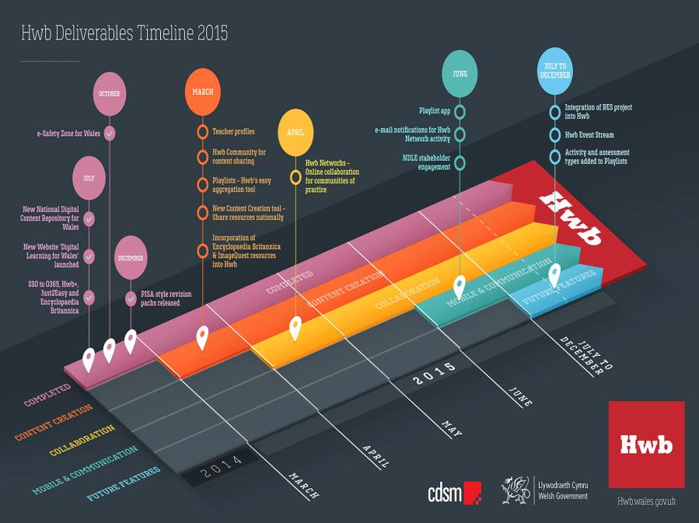

Slide 6
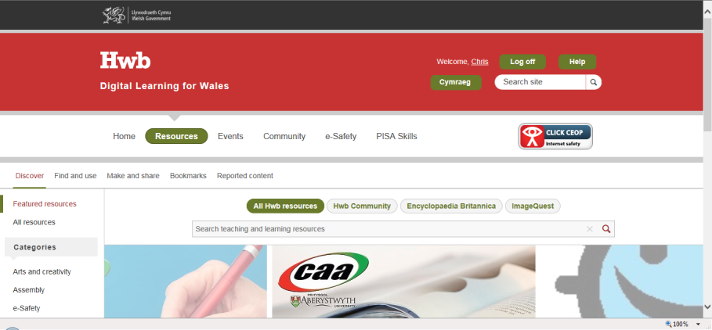
Improved searching
Search multiple sources of content, including Image Quest, Encyclopaedia Britannica and resources created by the Hwb Community

Slide 7
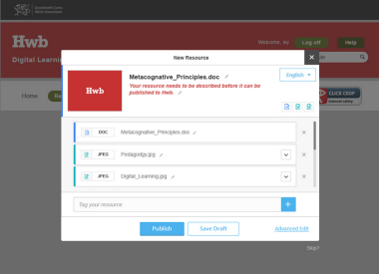
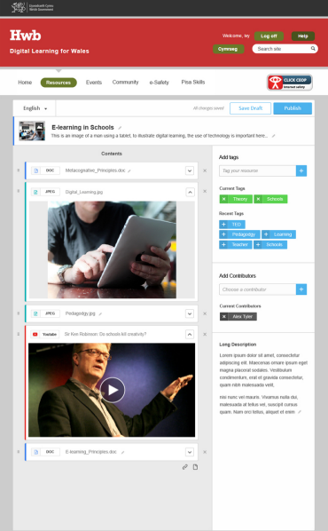
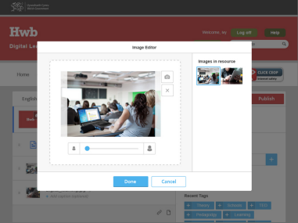
Content creation tools – Make and share

Slide 8
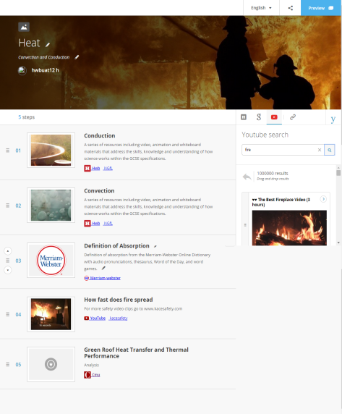
Playlists

Slide 9
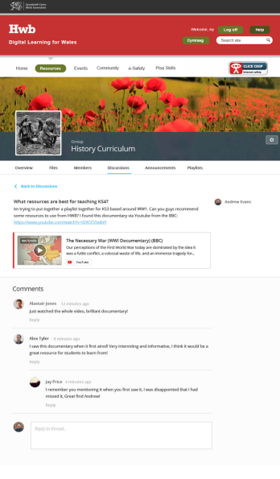
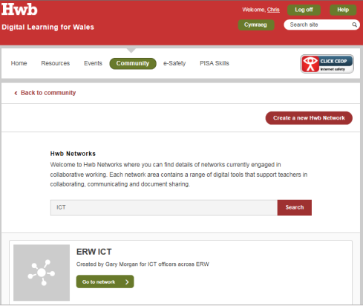
Hwb Networks

Slide 10





Additional tools and content available through Hwb
Just2easy
Encyclopaedia Britannica
360 degree safe Cymru
Premium content

Slide 11

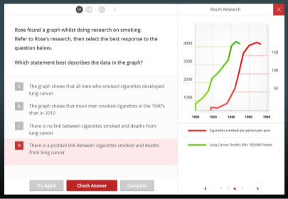
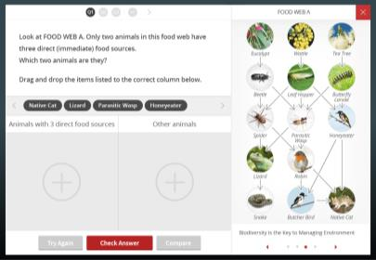

Slide 12
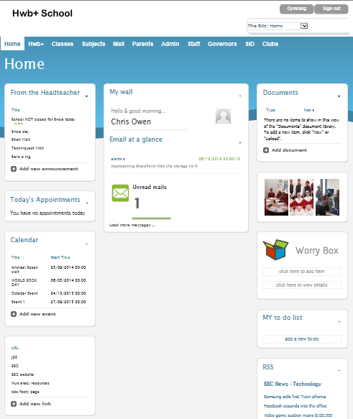
Hwb+ statistics
535,539 accounts active
April 2015
Total page views – 313,800
Logins – 108,505
More than 10 logins – 582 schools
Hwb+ Developments
Governors
Parents (additional service)

Slide 13
Governors
Pilot took place during March, with two schools:
Hendredenny Park Primary (Caerphilly)
Welshpool High School
(Powys)

Slide 14
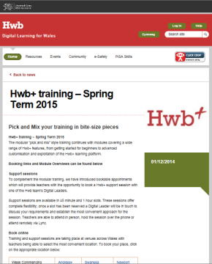
Digital Leader Hwb+ Training
Modules
Getting started with Hwb+
Supporting literacy within the LNF 1 & 2
Supporting numeracy within the LNF
Office 365
A strategic approach to Hwb+ for school leaders
Advanced Hwb+
Hwb+ and the paperless classroom
Staff communication
Network Managers
Digital Champions

Slide 15
Hwb+ Centres of Excellence Programme
50 schools applied to become one of eighteen Hwb+ Centres of Excellence - up to £30,000 per proposal
Aims:
the creation of up to 18 Hwb+ Centres of Excellence across Wales;
the development of a further 18 (minimum) Hwb+ accredited trainers;
the publication of an extensive suite of good practice materials, hosted via Hwb, exemplifying outstanding practice in a variety of settings;
the provision of Hwb+ professional learning opportunities for (a minimum of) 100 teachers in each regional education consortium area;
the development of (at least) 18 online professional learning communities across Wales; and
further evidence to support the wider Learning in Digital Wales Programme evaluation.

Slide 16
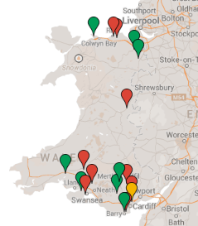
Hwb+ Centres of Excellence Programme
Hwb+ Centre of Excellence Schools
Lead School | Consortia | Local Authority
Cadoxton Primary School | CSC | Vale of Glamorgan
Porth County Community School | CSC | RCT
Cyfarthfa High School | CSC | Merthyr Tydfil
The Hollies | CSC | Cardiff
Ysgol Gyfun Bro Morgannwg | CSC | Vale of Glamorgan
Phillipstown Primary School | EAS | Caerphilly
Machen Primary School | EAS | Caerphilly
Ysgol Gynradd Gymraeg Pontardawe | ERW | NPT
Brynmill Primary School | ERW | Swansea
Ysgol Teilo Sant | ERW | Carmarthenshire
Abermule Primary School | ERW | Powys
Gowerton School | ERW | Swansea
Queen Elizabeth High School | ERW | Carmarthenshire
Hiraddug Primary School | North | Denbighshire
Ysgol Mair RC Primary School | North | Denbighshire
John Bright Comprehensive School | North | Conwy
Argoed High School | North | Flintshire
Ysgol Bryn Alyn | North | Wrexham

Slide 17
Learning in Digital Wales Professional Development Programme – Hwb+ Centres of Excellence extension
£250k across all four regions
Funding aimed at:
  supporting the Hwb+ Centres of Excellence across each region
  promoting the use of Hwb+ as part of effective teaching and learning;
  ensuring Hwb+ is measurably contributing to the core education objectives of improving literacy and numeracy and breaking the link between poverty and attainment;
  helping schools embed Hwb+ to support high-impact interventions;
  helping teachers develop their own digital literacy skills; and
  promoting “e-Safety” in relation to the safe and responsible use of Hwb+ tools including Office 365 and in relation to the digital technology more widely.

Slide 18


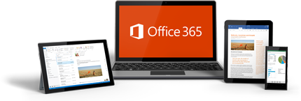
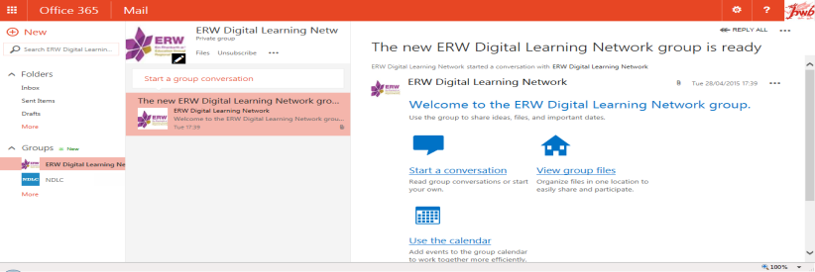

Slide 19
Outlook
  Option for schools (max 500) to Opt-in to a closed tenancy for their pupils – pupils can only send to fellow Hwb users.
  Disclaimer applied to all e-mails
  Ability for schools to apply a domain name for use with their staff accounts. E.g. ateacher@hwbmail.net and ateacher@aschool.co.uk
People
  Provide more information in the All Wales Staff address book
    To include school name, local authority and subjects
  Each school to have their own address book containing staff and governors
One Drive
  App developed to allow users to pass content from O365 to an area within Hwb+

Slide 20
SharePoint
  Update all user to correct regional settings:
    Time-zone = London,
    Locale = English (UK)
    First day of week = Monday
Search
  Exclude people from search
General
  Synchronise Hwb+ Avatars into O365
  Disable ability to purchase Apps
    Core Apps to be provided – suggestions from DLs (OneNote etc.)
  O365 Admins – nominated school admins to be able to view pupils e-mails and files
Groups
  Only staff to create groups
  Any user can be a member of a group
Changes ready to deploy to all schools

Slide 21
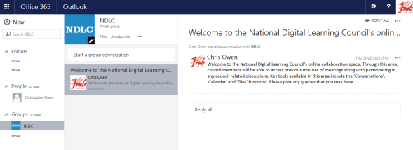
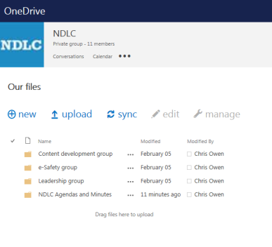
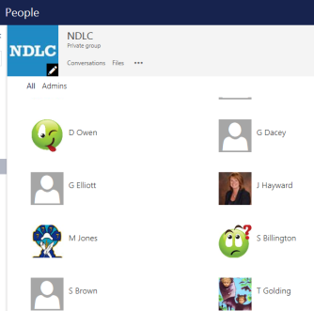
collaboration groups

Slide 22
LP Connect Tool
Workshop with key stakeholders held July 2014:
LAs
Learning Possibilities and Salamander Software (CT developers)
Summary of changes:
Log files easier to read
    Stored in a logical directory structure
    Full log files
    Summary log files
LA Dashboard (SharePoint Site)
    When CT was last ran
    Basic error info for each school
User Credentials List
    Identify school leavers
    Identify dual register users
Changes ready to deploy to all schools

Slide 23
South West Grid for Learning (SWGfL)
Feb 2015 - Minister agreed extension to existing e-Safety contract with SWGfL until March 2016.
Continuing support for 360 degree safe Cymru, Digital Learning Resources (DLR), e-Safety zone and CPD programme.
The DLR is attracting around 1000 page visits a month and 348 schools have already registered for the 360 degree safe tool.
Further engagement at local level from SWGfL (2 days per local authority)

Slide 24

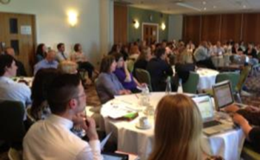
HwbMeets 2014/2015
Location: Numbers:
Aberystwyth 46
Anglesey 59
Swansea 52
Newtown 42
Cowbridge 38
Mold 58
Pembrokeshire 16 June
Pwllheli 7 July

Slide 25

Computing workshops for secondary schools update
Local workshops delivered for Python, LEGO, Scratch, Raspberry Pi and Java
Schools engaged – 52
Teacher attendees – 83
Learner attendees – 1490
4 x 6 week Python programming CPD modules delivered to 32 teachers

Slide 26
National Digital Learning Event 2015
24 June 2015
Digital Competence –
Sharing Good Practice
#NDLE2015

Slide 27
National Digital Learning Awards 2015
Best new resource created by teachers (for 3 to 11 year old learners)
Best innovative use of digital tools and resources in teaching (3 to 11 year old learners)
Best new resource created by teachers (for 11 to 16 year old learners)
Best innovative use of digital tools and resources in teaching (11 to 16 year old learners)
Best new resource created by teachers (for learners aged 16+)
Best innovative use of digital tools and resources in teaching (16+)
Best new commercial resource (any age group)
NDLC pupil award - for a resource, or for the innovative application of a resource by pupils, for pupils.
Closing date – 1 May

Slide 28
Learning in Digital Wales Evaluation
Aims
To evaluate how the Learning in Digital Wales (LiDW) Programme was implemented.
To evaluate whether the different strands of the LiDW Programme have met their identified objectives.
To identify any emerging impacts that the LiDW Programme is having on classroom practice for both teachers and learners.
Objectives
Assess the extent to which the overall aims and objectives of the different strands of LIDW Programme have been met, with a particular emphasis to be placed on Hwb, Hwb+ and the LiDW Grant.
Evaluate the overall process of the implementation of the LIDW Programme.
Assess whether there are differences in the level of take up of the different strands of the LIDW Programme across different schools in Wales and assess whether differences in levels of take up have affected schools.
Evaluate what impacts the LIDW Programme has had in terms of any changes to classroom practice that have been made as a result of the strands of the LIDW Programme.
Identify if and how learners’ attitudes and approaches to learning have changed as a result of the introduction of the LIDW Programme.

Slide 29
Key LiDW successes
Hwb and Hwb+ launch and provisioning (now over 540,000 users / 99% of schools), along with training of over 96% of schools
e-Safety training and content
LiDW connectivity grant (over 92% of eligible schools in Wales have benefitted)
Office 365 access available to all teachers and learners in Wales
LiDW Computing Workshop programme progressing well
Established schedule of HwbMeets (with over 600 teachers attending events to date)
National Digital Learning Council in its third year
3rd National Digital Learning Event to be run in Summer 2015
www.cymru.gov.uk

Slide 30
Key LiDW challenges
Scale of activity (complex, national model)
Supplier and contract management
Sustainability
Variation in use of digital technology in education across Wales
Delivery partner and stakeholder management
Resource challenges (internal and external)
www.cymru.gov.uk

Slide 31
Chris Owen
Digital Learning Division
hwb@wales.gsi.gov.uk
#hwbdysgu
www.cymru.gov.uk

