Slide 1



Welsh Government
Learning in Digital
Wales update
Thursday 10 September 2015
Notes:
1

Slide 2



www.cymru.gov.uk

Slide 3
Learning in Digital Wales work streams
Hwb (the National Digital Content Repository), Hwb Networks, Playlists, Hwb Community, third party tools and content
Hwb+ (the all-Wales learning platform)
Hwb+ Centres of Excellence Programme
Hwb+ public-facing websites
Microsoft Office 365
e-Safety including web filtering standards and information governance
Additional consortia funding to support the implementation of Hwb+ and the extension for Hwb+ Centres of Excellence
Computing workshops for secondary schools
Events including HwbMeets
National Digital Learning Event
Learning in Digital Wales Evaluation
Jisc
ICT Infrastructure - LiDWG and Janet
www.cymru.gov.uk

Slide 4
Outcomes
Increased learner attainment
Improvements in the use of digital technology
Financial benefits
Unified, consistent approach
Greater collaboration at all levels
Notes:
4

Slide 5

96% of eligible schools with enhanced connectivity (10/100Mbps) through a mostly-fibre deployment (c. £20m)
96% of schools with improved
Wi-Fi (£18m)
All local authorities with improved core connectivity
(up to 1Gbps)
LiDW Connectivity
Grant update

Slide 6
Hwb

Slide 7
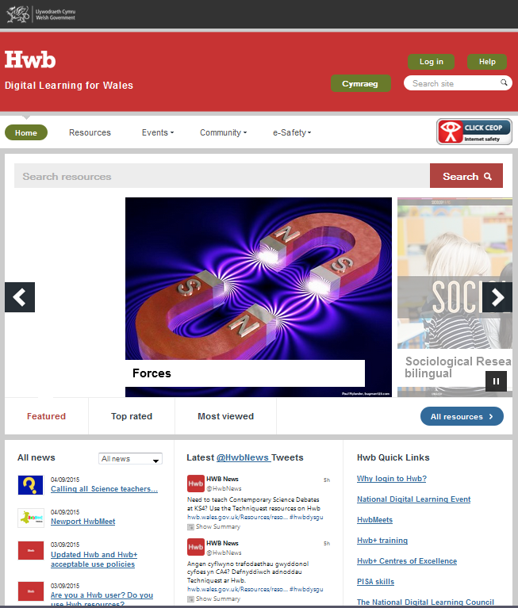
hwb.wales.gov.uk

Slide 8

Hwb Statistics
60,761 accounts active
Month | Page Views | Searches | Logins | Resources
April | 628,205 | 43,800 | 64,500 | 43,226
May | 757,963 | 44,000 | 78,800 | 80,303
June | 929,907 | 48,600 | 107,000 | 91,172
July | 442,425 | 21,000 | 52,500 | 46,072
August | 145,464 | 10,900 | 5,721 | 24,295

Slide 9

Improved searching
Search multiple sources of content, including Image Quest, Encyclopaedia Britannica and resources created by the Hwb Community

Slide 10
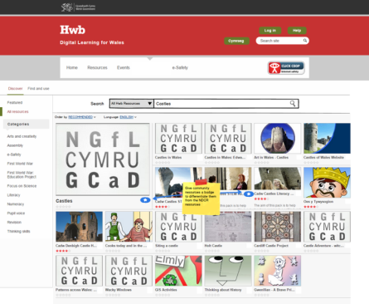
Hwb: Opt-in Community
Users can choose to join the Hwb community
Provides access to community generated resources
Community resources included in NDCR search results.
Community members – 1,945
Community resources created - 71

Slide 11
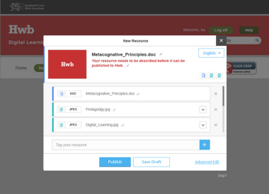
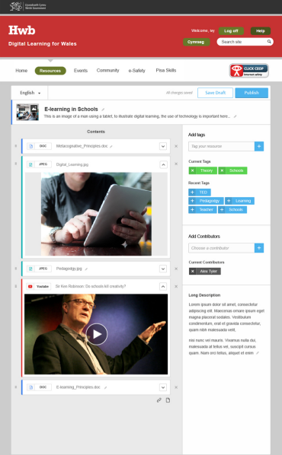
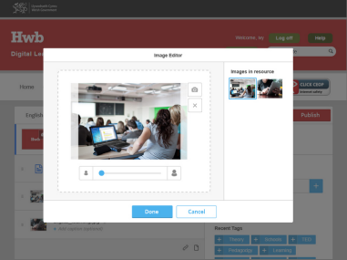
Content creation tools – Make and share

Slide 12
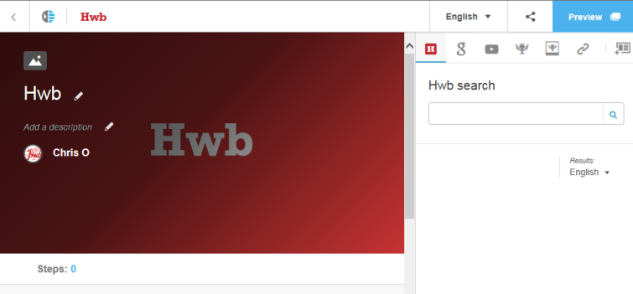
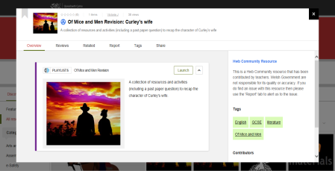
Playlists
June playlists logins: 2,720

Slide 13
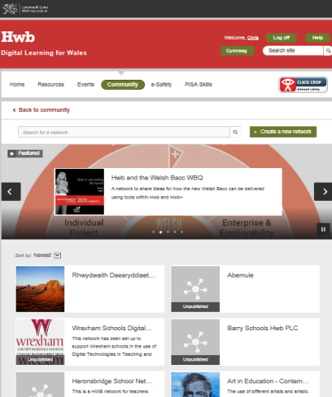
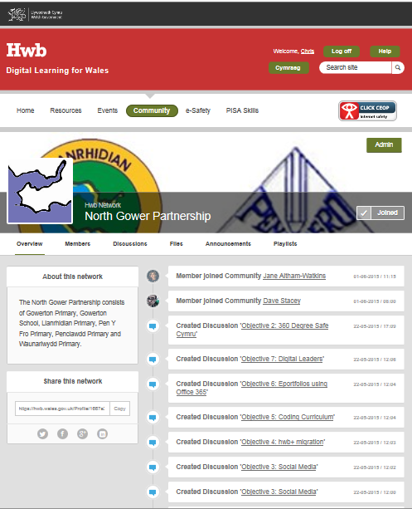

Hwb Networks
Total Hwb Networks created - 385
Total users joined Hwb Networks - 1,593

Slide 14
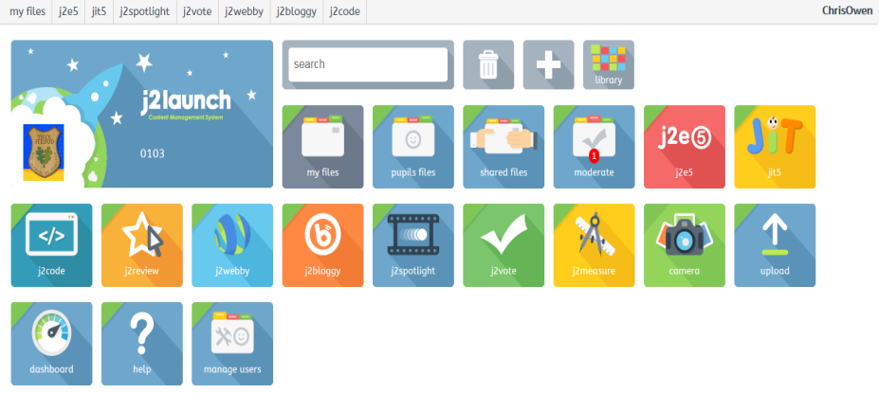
Just2easy is a collection of online educational tools specifically designed to engage, motivate, and inspire pupils.
The tools encourage pupils from Foundation Phase through to Key Stage 3 to create, share, and safely blog work at school and at home. It is also an effective resource for teachers, enabling file sharing, collaborative learning, and assessment and tracking.

Slide 15






Additional tools and content available through Hwb
Just2easy
Encyclopaedia Britannica
360 degree safe Cymru
Premium content
Creative Learning through the Arts

Slide 16

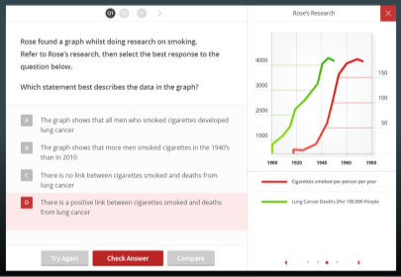
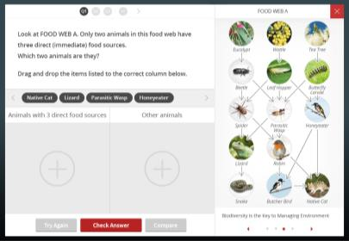
2,500 / month

Slide 17
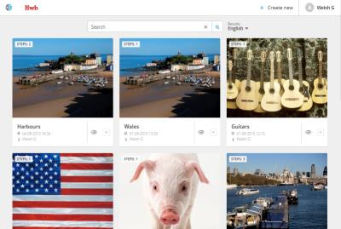
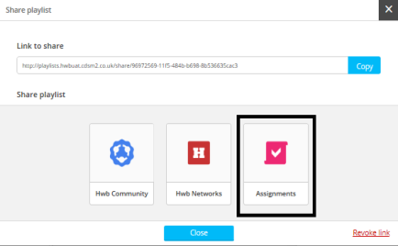
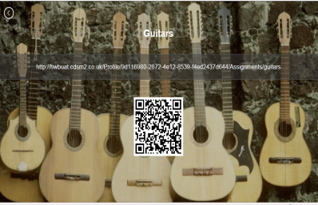
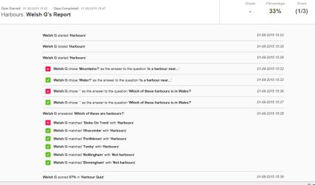
Assessment and reporting developments

Slide 18

Microsoft Office 365

Slide 19

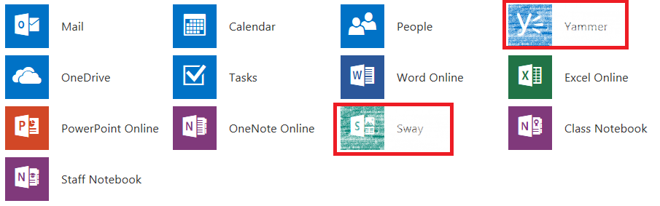
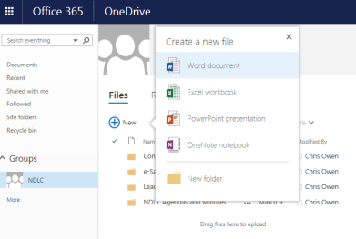
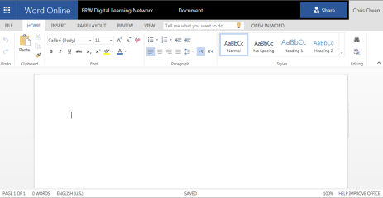

Slide 20
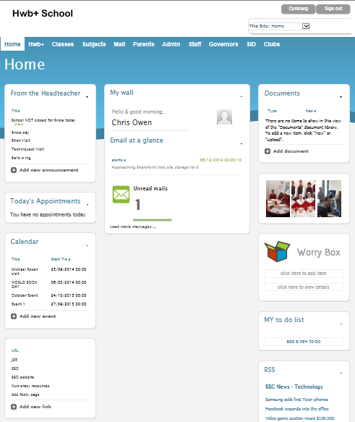
Hwb+ statistics
536,625 accounts active
June 2015
Total page views – 512,428
Logins – 166,793
More than 10 logins – 724 schools

Slide 21
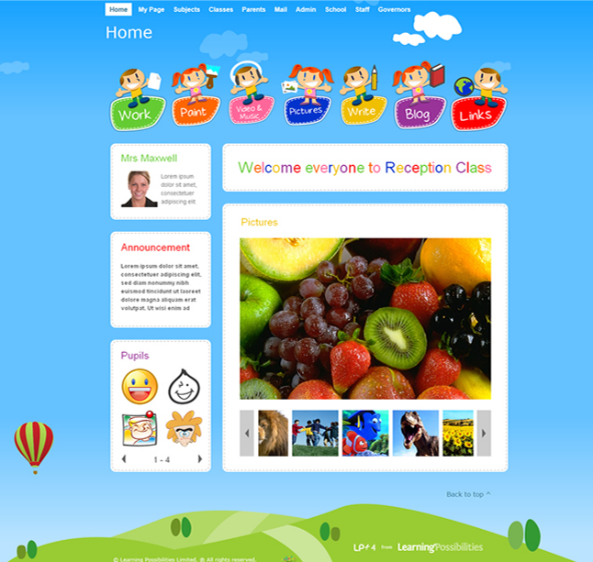
Hwb+ Learning Platform
Notes:
21

Slide 22
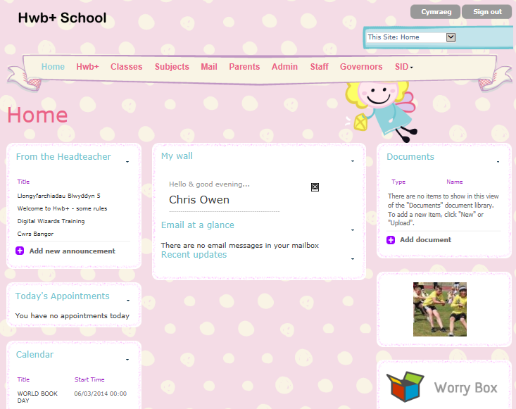
Hwb+ Learning Platform

Slide 23

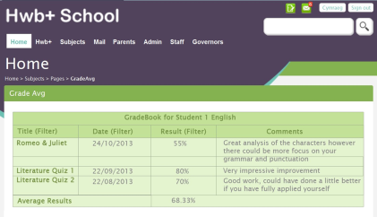
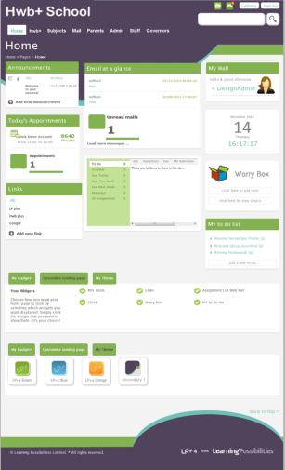
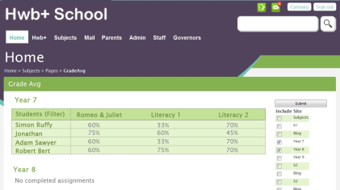
Notes:
23

Slide 24
Governors

Slide 25

An online extension of the classroom
Alderman Davies CiW Primary

Slide 26
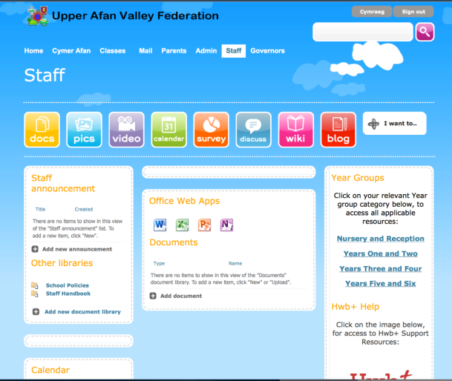
Creation of a shared staffroom for schools in the Upper Afan Valley Federation

Slide 27

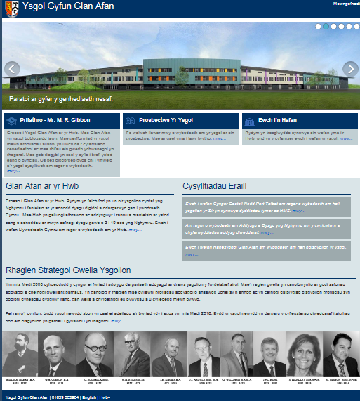
Hwb+ public-facing websites
Two websites, one English and one Welsh per school
Basic functionality which can be customised

Slide 28
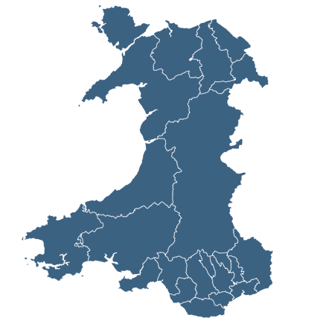





Digital Leaders
Alex Clewett
Peter Thomas
Dave Stacey
Glyn Rogers
Sonia McLaughlin

Slide 29
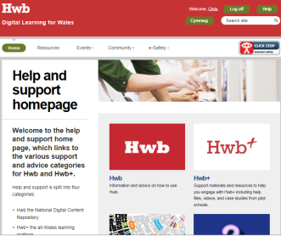
Digital Leader Hwb+ Training
Modules
Getting started with Hwb+
Supporting literacy within the LNF 1 & 2
Supporting numeracy within the LNF
Office 365
A strategic approach to Hwb+ for school leaders
Advanced Hwb+
Hwb+ and the paperless classroom
Staff communication
Network Managers
Digital Champions

Slide 30
Digital Leader Hwb+ Support
Weekly activities Primary training modules Secondary training modules Exemplar lessons INSET (school\cluster) Twilight (school\cluster) School Engagement Visit Case Studies SCC | Termly activities Strategic Engagement Planning (Action Plan) and Position Statement Hwb+ event (1 per LA) Hwb+ Celebration Day Hwb+ Centre of Excellence support visits Additional training modules SIG groups Case Studies Hwb+ Accredited trainer training
All support agreed with local authorities and RECs

Slide 31
Learning in Digital Wales Professional Development Programme
£750k across all four regions to March 2016
Funding aimed at:
  promoting the use of Hwb+ as part of effective teaching and learning;
  ensuring Hwb+ is measurably contributing to the core education objectives of improving literacy and numeracy and breaking the link between poverty and attainment;
  helping schools embed Hwb+ to support high-impact interventions;
  helping teachers develop their own digital literacy skills; and
  promoting “e-Safety” in relation to the safe and responsible use of Hwb+ tools including Office 365 and in relation to the digital technology more widely.

Slide 32





“We’re really enthused by this.
We’ve trained all departments and have distributed ownership throughout the school.
We have a rep for Hwb+ in every department.”
Rob Green, Digital Champion
Barry Comprehensive School
“We think it’s fantastic! Our children love doing work outside school on Hwb+!”
Jane Grubb, Digital Champion
Rhydypenau Primary School
“Collaborating with a school in North Wales continues to have a huge impact on our pupils - Hwb+ is changing the how and the why we learn.”
Aled Williams, Deputy Headteacher
All Saints Primary School
“We believe that when Hwb+ is used effectively, it can not only drive forward the key priorities such as literacy and numeracy but also support and enhance pupil’s learning experiences by allowing them to engage in multiple technologies all housed in a ‘walled garden’ environment.”
Emily Regan
Head of ICT
Risca Community Comprehensive School
“We have found Hwb+ to be a great way of providing extended, collaborative learning experiences for our children. The blog feature has been most effective when used to encourage children to reflect upon their learning.“
Paul Warren Headteacher
Bedwas Junior School

Slide 33
Learning in Digital Wales Evaluation
Aims
To evaluate how the Learning in Digital Wales (LiDW) Programme was implemented.
To evaluate whether the different strands of the LiDW Programme have met their identified objectives.
To identify any emerging impacts that the LiDW Programme is having on classroom practice for both teachers and learners.
Objectives
Assess the extent to which the overall aims and objectives of the different strands of LIDW Programme have been met, with a particular emphasis to be placed on Hwb, Hwb+ and the LiDW Grant.
Evaluate the overall process of the implementation of the LIDW Programme.
Assess whether there are differences in the level of take up of the different strands of the LIDW Programme across different schools in Wales and assess whether differences in levels of take up have affected schools.
Evaluate what impacts the LIDW Programme has had in terms of any changes to classroom practice that have been made as a result of the strands of the LIDW Programme.
Identify if and how learners’ attitudes and approaches to learning have changed as a result of the introduction of the LIDW Programme.

Slide 34
South West Grid for Learning (SWGfL)
Feb 2015 - Minister agreed extension to existing e-Safety contract with SWGfL until March 2016.
Continuing support for 360 degree safe Cymru, Digital Learning Resources (DLR), e-Safety zone and CPD programme.
The DLR is attracting around 1000 page visits a month and 348 schools have already registered for the 360 degree safe tool.
Suggest SWGfL attend NDLC event to discuss future requirements

Slide 35

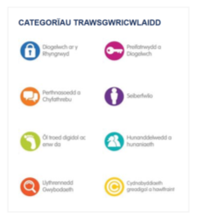
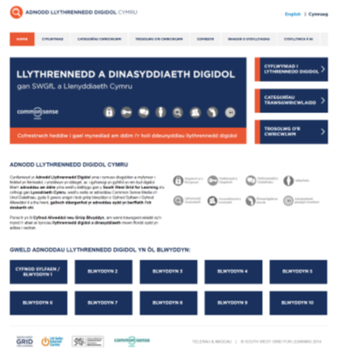

Notes:
35

Slide 36

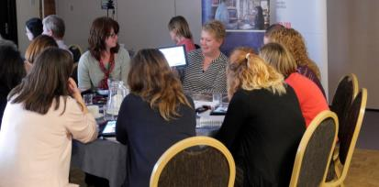
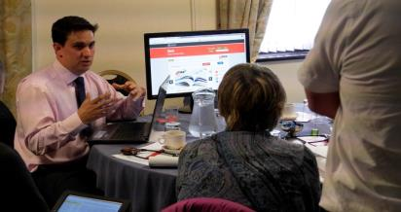
HwbMeets 15/16
29/09/15 – Newport
Lysaght Institute
20/10/15 - Llandudno
Ysgol John Bright
24/11/15 - Carmarthen
Queen Elizabeth High School
19/01/16 - Pontypridd
Porth County Community School
25/02/16 - Caerphilly
Phillipstown Primary School
17/03/16 - Bangor
Ty Menai
26/04/16 - Builth Wells
Builth Wells High School
17/05/16 - Cardiff
The Hollies School

Slide 37

Computing workshops for secondary schools update
Local workshops delivered for Python, LEGO, Scratch, Raspberry Pi and Java
Schools engaged – 142
Teacher attendees – 234
Learner attendees – 5891

Slide 38
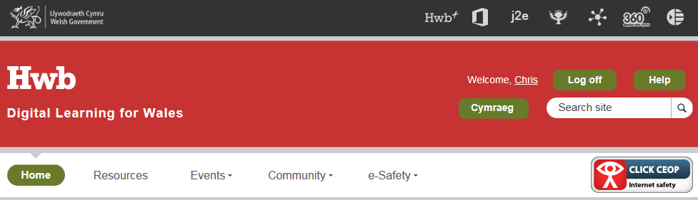
Why Hwb?

Slide 39
Digital Learning Division
hwb@wales.gsi.gov.uk
#hwbdysgu
www.cymru.gov.uk

